Slide 1

Rationale
Introduction to Windows Store App Development Using HTML5 and JavaScript
Computer science is a field of study that deals with solving a variety of problems by using computers.
  To solve a given problem by using computers, you need to design an algorithm for it.
Multiple algorithms can be designed to solve a particular problem.
An algorithm that provides the maximum efficiency should be used for solving the problem.
  The efficiency of an algorithm can be improved by using an appropriate data structure.
Data structures help in creating programs that are simple, reusable, and easy to maintain.
This module will enable a learner to select and implement an appropriate data structure and algorithm to solve a given programming problem.

Slide 2
Objectives
  In this session, you will learn to:
  Implement navigation in a Windows Store app
Notes:
2

Slide 3
Passing Information Between Pages
  To pass information between pages, you can use the WinJS.Navigation.navigate() function, which possesses the following syntax:
    WinJS.Navigation.navigate(URI, objects)
  The passed information is available as a parameter of the ready() function of the destination page.
Path of the target page that needs to be navigated
Information that needs to be passed to the target page
Notes:
3

Slide 4
Passing Information Between Pages (Contd.)
  The following code snippet navigates to the Stories.html page and passes information through the newStory object:
    WinJS.Navigation.navigate("/pages/Stories/Stories.html", newStory);
  The following code snippet accesses information in the ready() function:
    ready: function (element, options) {
    //Display the details on the Stories page
    txtStoryTitle.innerText = options.Title;
    txtStoryContent.innerText = options.Content;
    }
Let us look at an example, which passes information between pages of an app
Notes:
4

Slide 5


Just a Minute
  Which one of the following statements represents the correct syntax to pass information between pages while using the navigate() function?
    1. WinJS.Navigation.navigate(URI, objects);
    2. WinJS.Navigation.navigate(objects, URI);
    3. WinJS.Navigation.navigate(objects);
    4. WinJS.Navigation.navigate(URI);

Slide 6
Just a Minute (Contd.)
  Solution:
    1. WinJS.Navigation.navigate(URI, objects);

Slide 7
Loading HTML Fragments
  To reduce the app’s load time:
  An HTML fragment contains the HTML markup that can be loaded dynamically into a page.
You can load only those files that are required for the first page.
Then, load the rest of the files whenever required by using the HTML fragments.
Notes:
7

Slide 8
Loading HTML Fragments (Contd.)
  To load the HTML fragments dynamically, you can use the WinJS.UI.Fragments.render() function.
  You can use the following syntax to invoke this function:
    WinJS.UI.Fragments.render(<URI>, [Element]);
Is the URI of the HTML page that contains the HTML fragment.
Is the identifier of the element to which the HTML fragment is loaded. It is an optional
parameter.
Notes:
8
Explain the parameters of the syntax.

Slide 9

Demo: Implementing Navigation
  Problem Statement:
  Allen is a Windows Store app developer. He has been assigned the task to develop a Photo Album app. This app should display the photos available in the album, as shown in the following figure.
Notes:
9

Slide 10
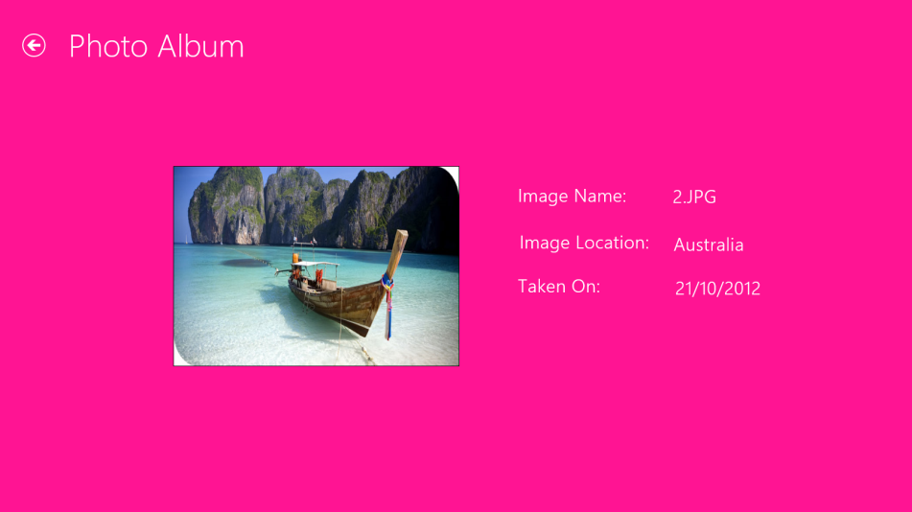
Demo: Implementing Navigation (Contd.)
  Further, when a user clicks a photo, the app should navigate to a new page, which contains the photo and its description, as shown in the following figure.
  In addition, every such page should allow the user to go back to the main page of the app. Help Allen to accomplish the preceding task.
Notes:
10

Slide 11
Demo: Implementing Navigation (Contd.)
  Solution:
  To create the Photo Album app, Allen needs to perform the following tasks:
    1. Create a Windows Store app by using the Navigation App
    template.
    2. Add image files in the project.
    3. Design the UI of the Home page.
    4. Add styles to the Home page.
    5. Make the Home page functional.
    6. Design the UI of the Description page.
    7. Add styles to the Description page.
    8. Make the Description page functional.
    9. Execute the app and verify the output.
Notes:
11

Slide 12
Summary
  In this session, you learned that:
  To pass information between pages, you can use the WinJS.Navigation.navigate() function.
  The passed information is available as a parameter of the ready() function of the destination page.
Notes:
12

Slide 13

Q&A

